Slide 1
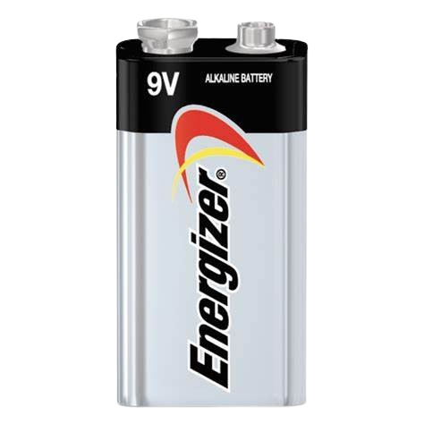
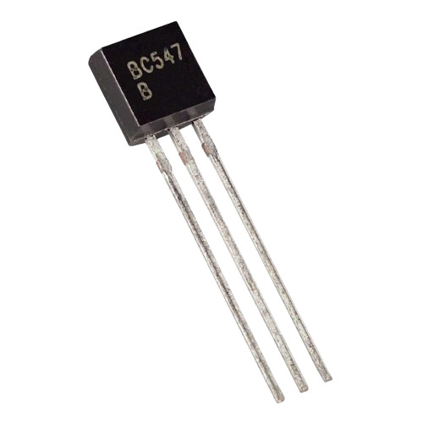
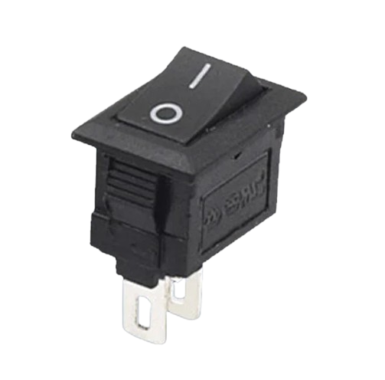
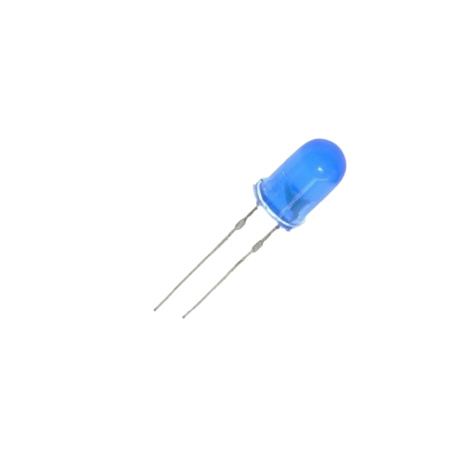
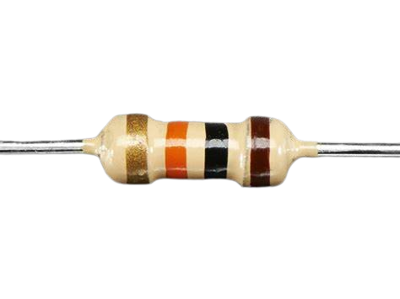
Buda Tech
TTL OR GATE
SWITCHES
BATTERY
NPN TRANSISTORS
RESISTORS
RESISTORS
LED

Slide 2

Buda Tech
TTL OR GATE
S1 S2
E B C
1k
1k
E B C
220
1k

Slide 3
Buda Tech
TTL OR GATE
S1 S2
E B C
OPEN
OPEN
1k
1k
S1 | S2 | LED
0 | 0 | 0
E B C
220
1k

Slide 4
Buda Tech
TTL OR GATE
T1
OFF
S1 S2
E B C
OPEN
OPEN
T2
OFF
1k
1k
S1 | S2 | LED
0 | 0 | 0
E B C
220
1k

Slide 5
Buda Tech
TTL OR GATE
S1 S2
E B C
OPEN
CLOSED
1k
1k
S1 | S2 | LED
0 | 1 | 1
E B C
220
1k

Slide 6
Buda Tech
TTL OR GATE
S1 S2
E B C
OPEN
CLOSED
1k
1k
S1 | S2 | LED
0 | 1 | 1
E B C
220
1k

Slide 7
Buda Tech
TTL OR GATE
S1 S2
E B C
CLOSED
OPEN
1k
1k
S1 | S2 | LED
1 | 0 | 1
E B C
220
1k

Slide 8
Buda Tech
TTL OR GATE
S1 S2
E B C
CLOSED
OPEN
1k
1k
S1 | S2 | LED
1 | 0 | 1
E B C
220
1k

Slide 9
Buda Tech
TTL OR GATE
S1 S2
E B C
CLOSED
CLOSED
IB
1k
1k
S1 | S2 | LED
1 | 1 | 1
E B C
IB
220
1k

Slide 10
Buda Tech
TTL OR GATE
S1 S2
E B C
CLOSED
CLOSED
IB
1k
1k
S1 | S2 | LED
1 | 1 | 1
E B C
IB
220
1k

